Slide 1

Tittle:
Waterfall Process Operations in the Fast-paced World: Project Management Exploratory Analysis (2021)
Author: Harkirat Kaur Aroral
Presented By:
MUHAMMAD USAMA ANSAR
(BSCS-F19-A-14)

Slide 2

Business
Analysis
Introduce by Winston W. Roylee in 1970
SDLC Approach
Complete before next phase
Used in new era
Design
Implementation
Testing
Maintenance
INTRODUCTION

Slide 3

Authors
Youssef Basil
Savita Gupta ...,
et al
Sujit Kumar ...,
et al
Baikal ...,
et al
Jerzy, Kisielnicki ..., et al
Methodology
PMBOK
V Shaped & Agile
Traditional & Agile
DevOps
Research
Analysis/Solution
Waterfall model is SDLC
SDLC affect under conditions
Comparison of agile and traditional
DevOps is another project management methodology
Agile is effective as compare to waterfall
Years
2012
2012
2013
Literature
Review
2017
2017

Slide 4

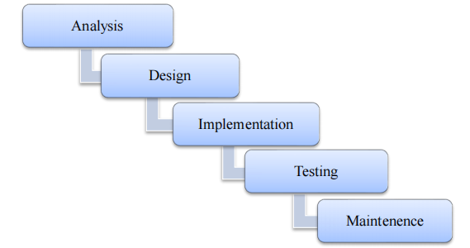
Methodology
Waterfall
Approach

Slide 5

Waterfall Method in Today’s World
Not much efficient in today’s Business
Does not work for large project
Time taking
Leave unfinished tasks
Suited for predictable Environment
Today’s world is unpredictable
Because of these reasons Waterfall model is not much popular today.
Discussion

Slide 6

This paper was about waterfall methodology.
Conclusion
Methodology has been discussed.
It ends with whether waterfall methodology is useful to the today’s world.

Slide 7

THANK YOU

